Slide 1
IMPLEMENTING AN EXAM SCHEDULING ALGORITHM USING GRAPH COLOURING
Team Number : 22
Team Members: Akshith Bellare (181IT104)
Amith Bhat (181IT105)
Laharish S (181IT125)
Samarth S Hadimani (181IT240)

Slide 2
INTRODUCTION

Slide 3
Graph colouring is an area of graph theory where the elements of a graph are assigned a label(“colour”) subject to certain constraints. Graph colouring is generally used to solve problems where a variety of conditions are set on the problem statement, such as scheduling and allocation problems.
In this project, we use vertex colouring to solve an exam scheduling problem.

Slide 4
REQUIREMENT ANALYSIS

Slide 5
HARDWARE REQUIREMENTS
Processors: Will run on Intel Pentium and newer
Hard Disk : 1 TB
RAM : 4 GB

Slide 6
SOFTWARE REQUIREMENTS
OS : Windows 10/ Ubuntu 14.04 and upwards
Requires Python 3.x interpreter.
Python libraries such as numpy and fpdf.

Slide 7
PROBLEM STATEMENT

Slide 8
To provide a schedule for an examination held in an institution (solving the exam-scheduling problem) within some constraints.
We solve this problem using the node graph colouring technique.

Slide 9
ISSUES & CONSTRAINTS

Slide 10
Things to look out for -:
Avoid conflicts, ie, no student must have two or more exams in the same time slot.
Achieve fairness, ie, build a fair schedule by allowing no more than 2 exams for a particular student on a day. Also, there must be appropriate distance between two exams for a student.

Slide 11
Hence, the constraints we have considered are as follows:
The number of exam periods/time slots in a day(set by authorities).
Number of concurrent exam sessions(set by authorities).
No more than 2 exams per day for any student(fairness requirement).
Number of exam days(set by authorities).

Slide 12
FAIRNESS PARAMETERS

Slide 13
We have considered 3 main parameters for determining fairness. They are:
1. Internal Distance(D₁) : Exam scattering across different slots on the same day for the same set of students.
2. External Distance(D₂) : Exam scattering across different days for the same set of students.
3. Total Distance(D₃): (gamma * D₂) + D₁
Gamma is the factor which decides the distance between two exams for a student.

Slide 14
COLOURING SCHEME

Slide 15
The coloring scheme for the exam-scheduling problem uses a double indexed color (R_{IJ}), where the index (I) represents the day of the exam and (J) represents the exam time slot on a given day. As mentioned earlier, both factors can be set in the program.
The coloring scheme allows two or more non-adjacent nodes to have the same color(R_{IJ}).
The scheduling algorithm (provided in the subsequent sections) allows the user to impose a maximum limit on the number of available instances of color R_{IJ}. This means that, as a colour represents a specific day and slot in the timetable, a limit can be imposed on the number of exams conducted at the same time.

Slide 16
IMPLEMENTATION DETAILS

Slide 17
In addition to the constraints previously mentioned, during the practical implementation of our project, we have sorted the courses with the ones with largest degree kept first. These courses are alloted the first slots of the timetable(ie, slots in Day 1 ) as much as possible. This is done to minimize the risk of future conflict.
In this project, we have also considered the fact that, to avoid chances of copying, students of two different courses are often seated in the same exam hall, ie, students of course A sit in the odd-numbered rows while students of course B sit in the even-numbered rows.

Slide 18
For the purposes of this project, we have considered the limit for the number of simultaneous exams(ie, number of instances of colours available) regarding only the number of lecture halls available. Other factors such as availability of TAs has not been considered.

Slide 19
THE ALGORITHM

Slide 20
As mentioned, in this algorithm, we have considered the courses to represent the nodes of the graph. The edges, then represent the number of students common to the two nodes(which are being linked).
A weight matrix is constructed, which consists of the number of common students/“weights” of each edge.
A colour, R_{IJ} is said to be smaller than that of another colour R_{GH} , if the value of that colour, V(R_{IJ}) < V(R_{GH}) .
To ensure that the largest courses get the first preference, we have instituted a rule that a course will get the smallest possible colour. Since we sort the courses such that courses degree are allotted first, we are able to allot them the smallest colour, ie, the slots in the first couple of days.

Slide 21
The algorithm consists of two major steps:
Building the weight matrix and graph from the data files.
2. Assigning the colours to the nodes of the graph.

Slide 22
In the first step, we find the data files, and convert the data into a usable format. We process the data by filling the list of courses.
Then, for each node, we find the set of adjacent nodes, and calculate the common students between them. This value is inserted into the weight matrix.
The weight matrix is then used to build the graph.
The degree of each node is also calculated to help in the ordering of the graph.

Slide 23
In the second step, the nodes in the graph are assigned colours. The nodes are ordered in descending order based on their weight.
When the algorithm runs, if a node is found to be uncoloured, there are two possible cases: If it is the first node, it initializes the colours. Else, it gets the smallest available colour.
After assigning a colour to a node, it then assigns the smallest possible colours to its adjacent nodes as well, if they are not coloured.
The program terminated when all nodes possible are coloured; if there are any uncoloured nodes, ie, any unallotted courses, it returns the number of unallotted courses along with the list of allotted courses.

Slide 24
RESULTS AND SCREENSHOTS

Slide 25
The program outputs two PDF files, course-slot.pdf and slot-course.pdf, along with corresponding output in the terminal.
In the course-slot.pdf file, the course is mapped to a particular day-slot pair and lecture hall number.
Eg: AE211 :: Day 5 Slot 3, Rooms : LH017 even-rows, Strength: 60
In the slot-course.pdf file, the day-slot pair is mapped to a list of courses.
Eg: Day 1 Slot 4
Courses :: ['MSE799', 'EE602', 'MTH308', 'CHM322', 'ME452', 'CE382', 'CHE331', 'MSE689', 'EE698I', 'AE361'] Students 654

Slide 26
In case of any unallotted courses, both PDFs will contain warnings at the top and bottom of the file.
We created both kind of files targeting different users. The course-slot.pdf file would be useful for students and other exam-takers, while the slot-course.pdf file would be useful for the administrators of the examination.
The screenshots are as follows:

Slide 27
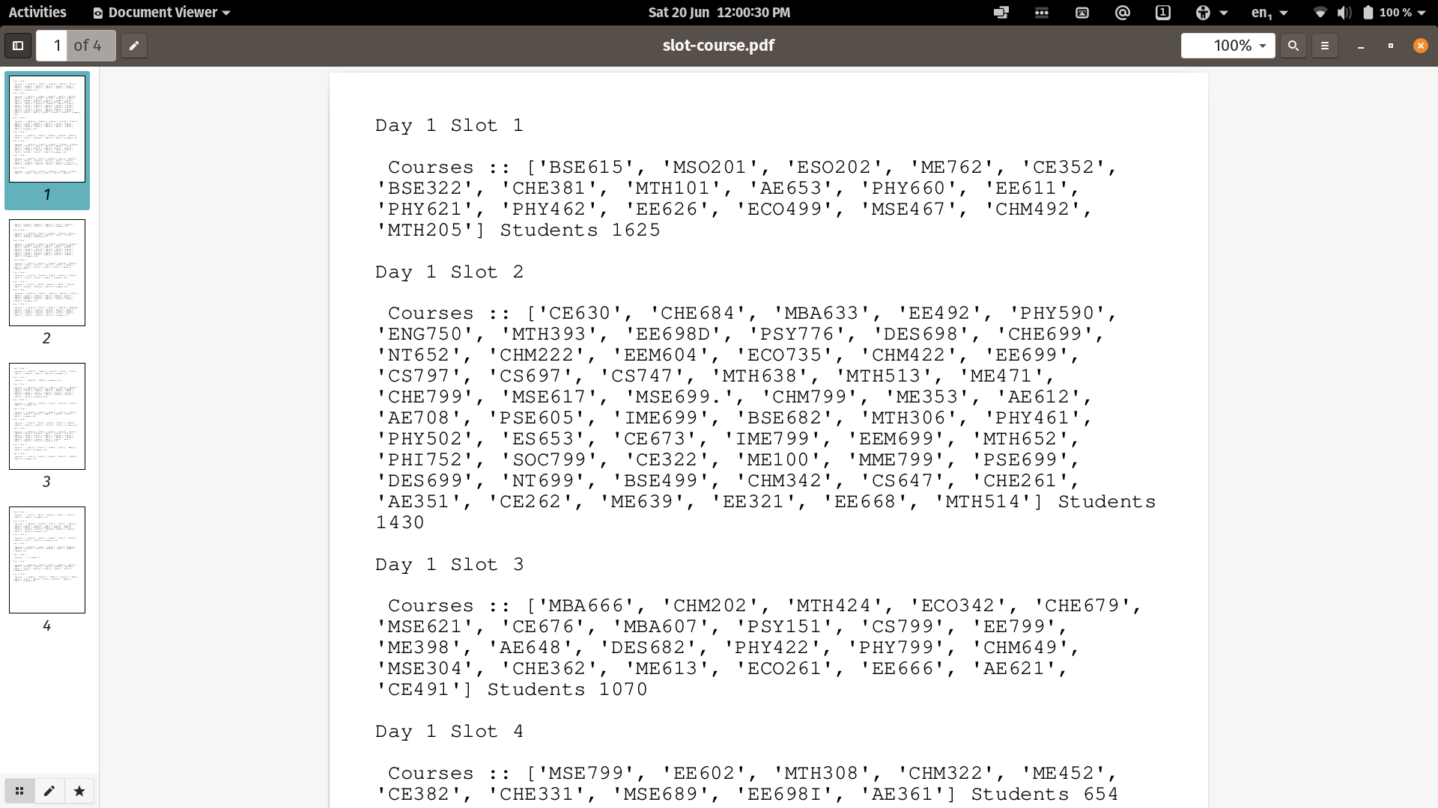

Slide 28
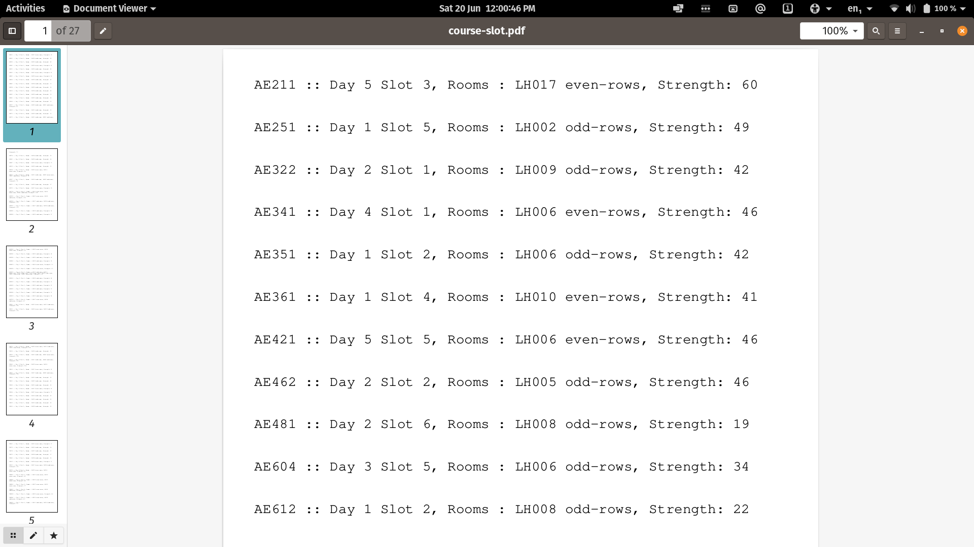

Slide 29
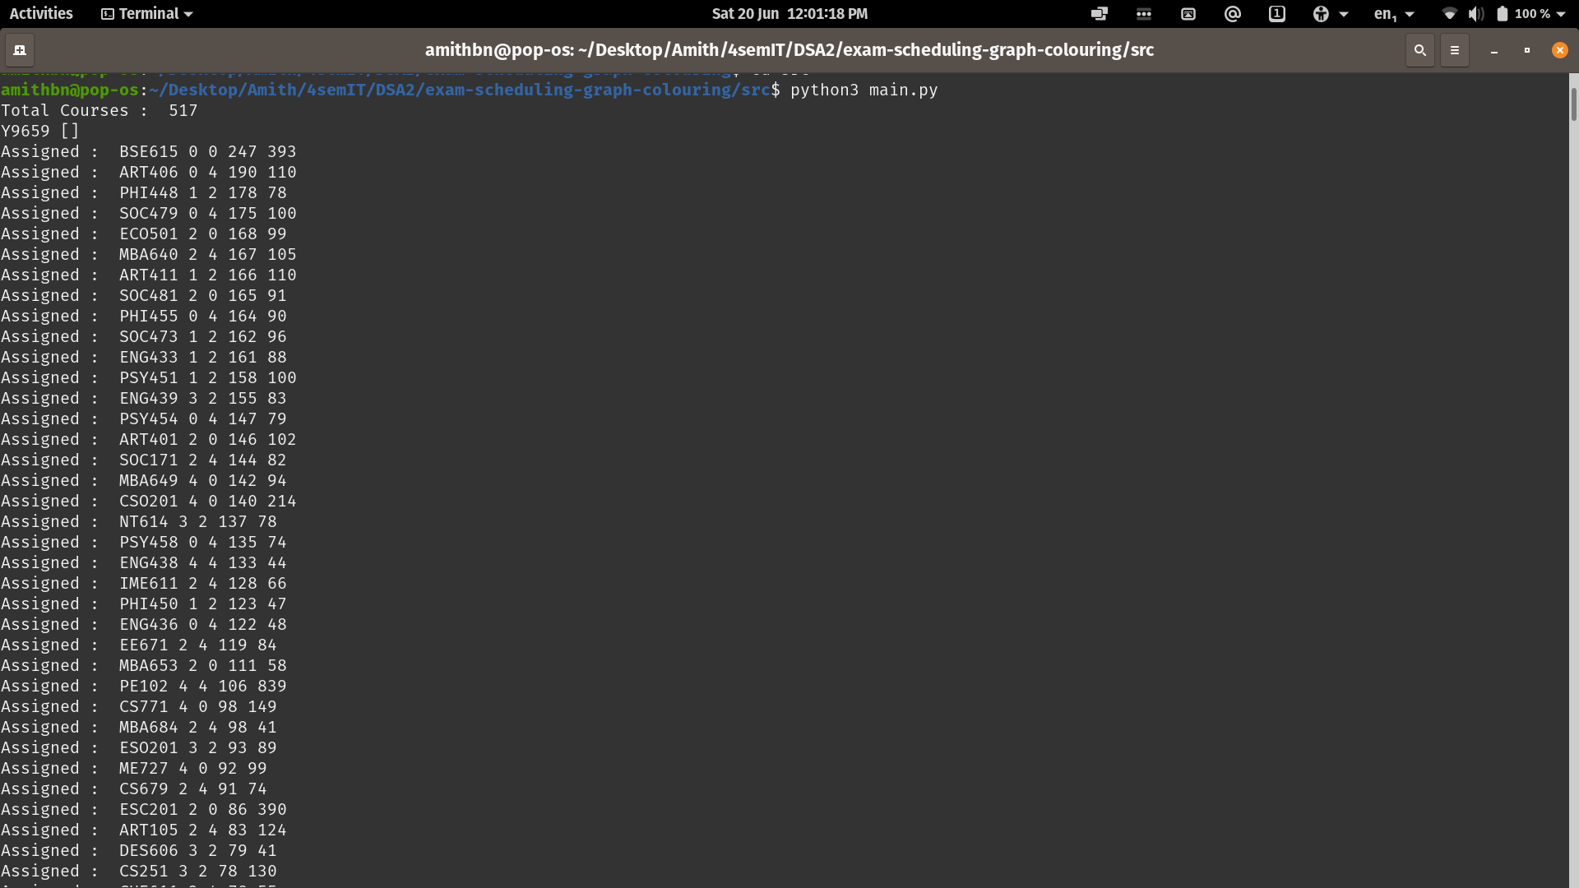

Slide 30
CODE DEMONSTRATION

Slide 31
THANK YOU

